Slide 1
Economic and administration school School for design, graphics and sustainable building Split

Slide 2
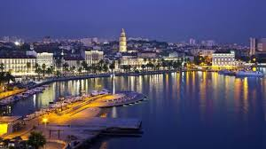
Split
Notes:
The city we are coming from is one of most beautiful city in Dalmatia region.

Slide 3
Geographic location
town is located on the Adriatic sea
between mountains Mosor and Kozjak
Notes:
geographic location: Town is located on Adriatic sea, between mountain Mosor and Kozjak.

Slide 4
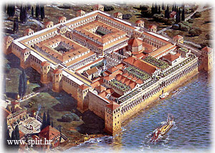
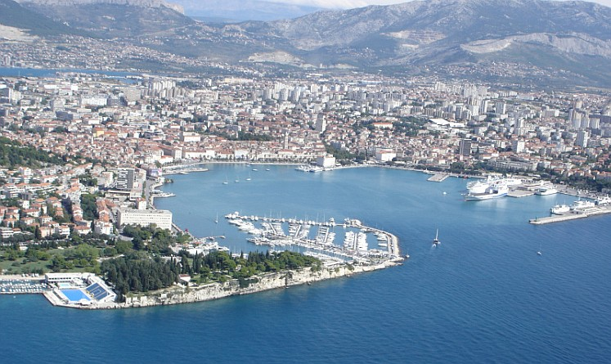
From palace to city
The Roman Emperor Diocletian builds a palace from 295. to 305.
from 1979. the palace has been protected by UNESCO

Slide 5
Cathedral St. Duje

Slide 6
Historical sights
Vestibul
Podrumi

Slide 7
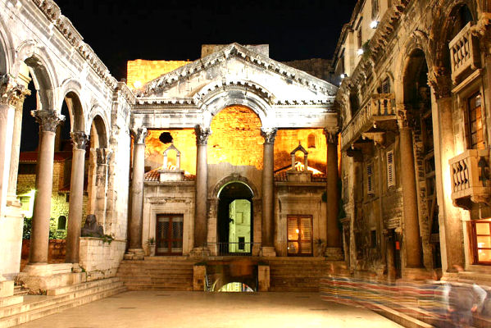
Peristil

Slide 8
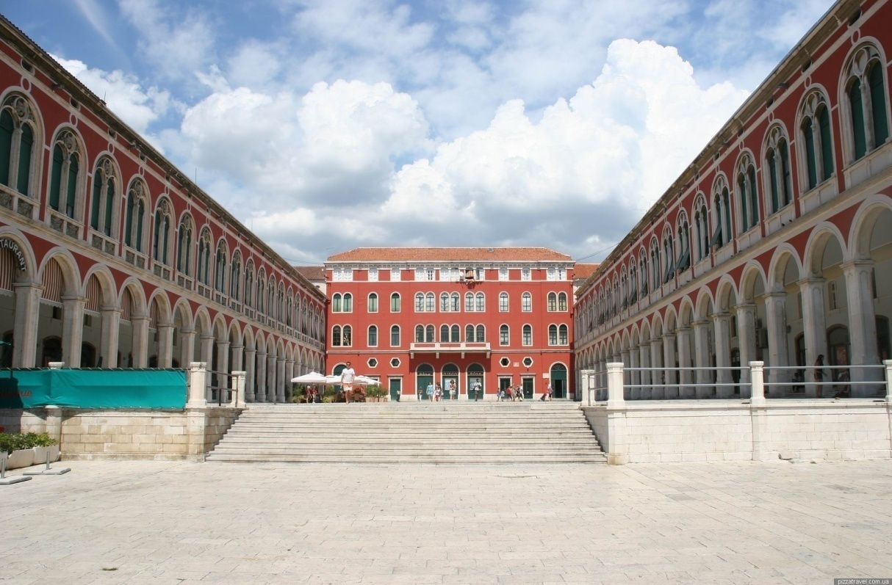
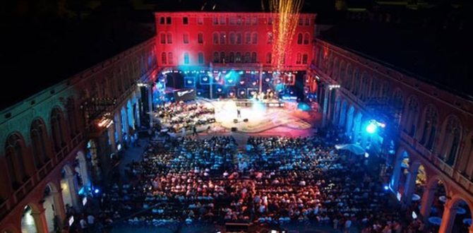
Prokurative

Slide 9
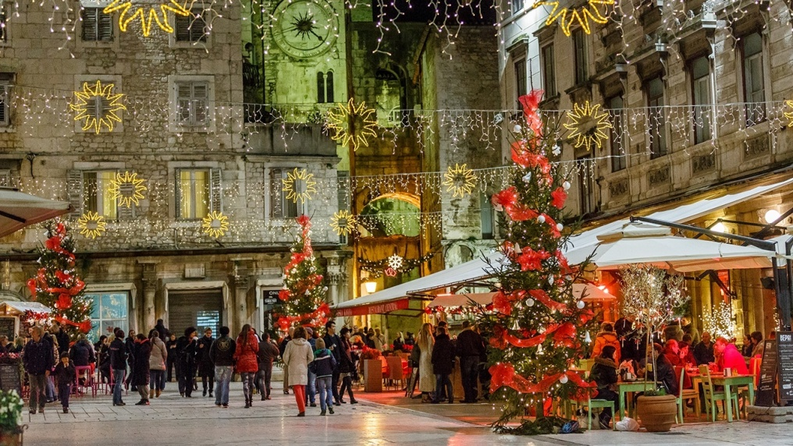
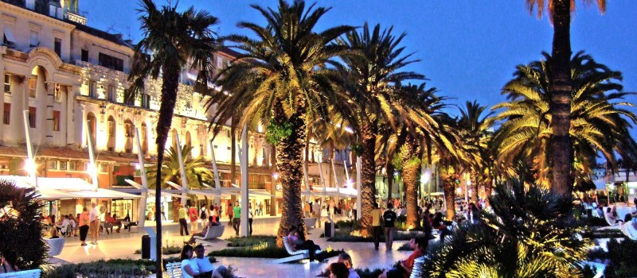
Social events

Slide 10
Museums
Etnografski muzej
Galerija Meštrović
Galerija umjetnina
Arheološki muzej
Muzej grada Splita

Slide 11
Tourism in Split

Slide 12
Tourism in Split
Grad | Dolasci |  |  | Noćenja
 | Domaći | Strani | Ukupno | Domaći | Strani | Ukupno
2012 | 44.558 | 235.649 | 280.207 | 91.327 | 657.841 | 749.168
2014 | 41.802 | 352.252 | 394.054 | 103.382 | 1.007.997 | 1.111.379
2016 | 58.557 | 516.458 | 575.015 | 131.652 | 1.631.457 | 1.763.109

Slide 13
Economic and administration school Split
established in 1905.
Since 1962 at Vukovarska 37

Slide 14
Educational programs in school
Economist
Administrator
Secretary
experimental programs - economic grammar school
http://ss-ekonomsko-birotehnicka-st.skole.hr/

Slide 15
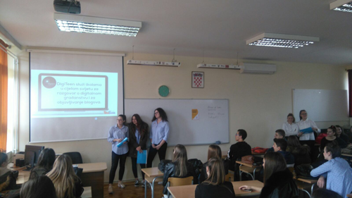
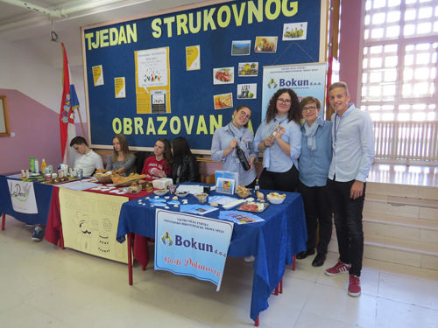
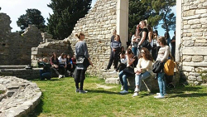
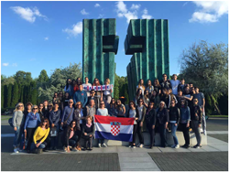
Various activities of students and teachers
Teaching outside school – visiting The Croatian Parliament, financial organizations, trade fairs, theatres, museums, book fairs and field trips to locations of historical, archaeological and other educational value.
Yearly humanitarian manifestation: students and teachers engage in sport activities in order to obtain funds for those in need within our local community.
Participation in the European Vocational Skills Week 2017

Slide 16
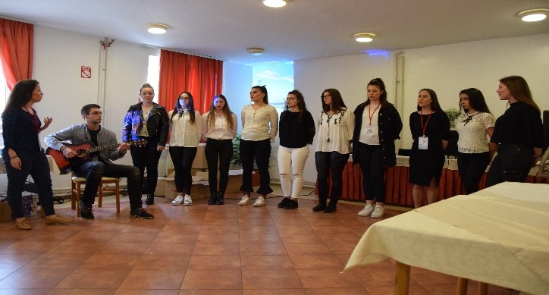
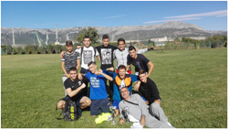
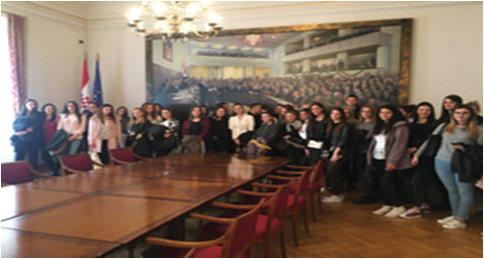
Various activities of students and teachers
Journalism – group of students create yearly school newspapers under supervision and guidance of chosen teacher
Drama and reciters group – group of students prepare poetry and literature performances for special occasions in our school
School sports section OKTOPUS organizes students who compete against students of other schools in our town, region and country in sports such as basketball, football, volleyball, handball, cross running, badminton etc.

Slide 17
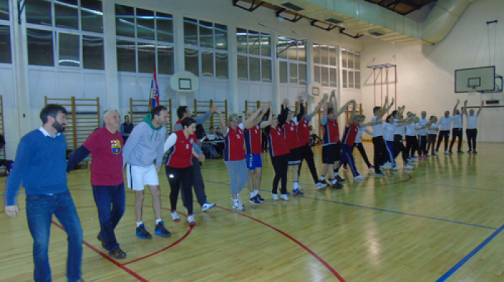
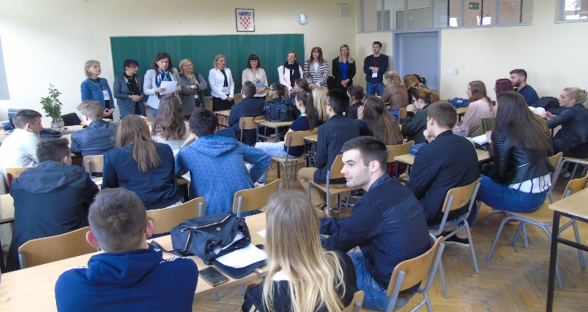
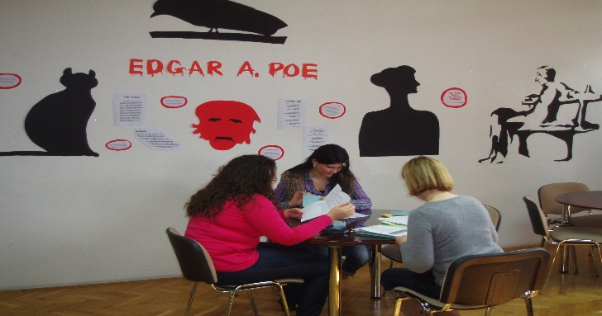
Various activities of students and teachers
Our students compete and are very successful in school, regional and national contests at subjects such as Croatian, English, IT, Accounting, Statistics, Young entreprenuer etc.
Our library has the largest book fund in our region compared to other school libraries and vivid cultural and public activities
Teachers’ choir

Slide 18
School for design, graphics and sustainable building
www.gogss.hr

Slide 19
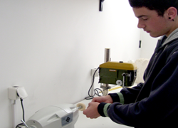
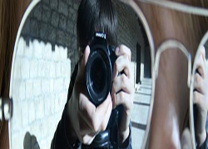
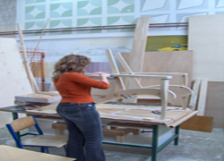
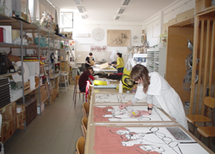
Educational programs in school
1. Graphic educationd programs
Web designer and media technican
Prepress tehnician
Editorial graphic designer
2. Grammar school of sustainable development
3. Art and design educational programs:
Interior designer
Decorator and set designer
Ceramics and metal designer
4. Construction educational programs

Slide 20
Curriculum “ Media in contemporary sociaty”
The goal of our curriculum is to develop a critical attitude of students when analyzing media contents.
students are able to search independently network resources and select relevant information
students learn how to idenify product placement set in the context of media revelations
students are aware of relevance of ethics in media releases

Slide 21
Curriculum “ Financial Literacy”
Basic financial terms that are important to make a personal financial planning
students are able to explain various financial businesses
students can find financial products and services
students compare different ways of investments
developing personal financial planning
students use various financial forms
students can compare financial services online
students are prepared to present their financial plans

